Slide 1
Lecture 3 Sorting Algorithms

Slide 2
Outline
Insertion sort
Quick sort

Slide 3

Sorting Algorithms
Insertion Sort
Simple, but it does not have very good performance
Insertion Sort
Simple, but it does not have very good performance
It still does not have good performance but it might be useful in practice, when the array is already partially sorted.
It has quadratic performance in the worse case scenario.
Notes:
Elements tend to move up into the correct order like bubble rising to the surface

Slide 4
Sorting Algorithms
Insertion Sort
Simple, but it does not have very good performance
It still does not have good performance but it might be useful in practice, when the array is already partially sorted.
Notes:
Insertion sort may not work well for large lists

Slide 5
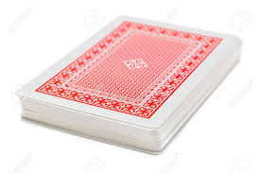



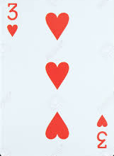
Insertion Sort – How it Works

Slide 6
Insertion Sort – How it Works
Index i points to the second element of the array
j is set = i
i, j

Slide 7
Insertion Sort – How it Works
j-1
i, j

Slide 8
Insertion Sort – How it Works
If the element at a index j is smaller than the element at index j-1, the two elements are swapped
j-1
i, j

Slide 9
Insertion Sort – How it Works
j-1
i, j

Slide 10
Insertion Sort – How it Works
Let’s decrement j until it is > 0
j
i

Slide 11
Insertion Sort – How it Works
Let’s increment i
Lets set j = i
i,j

Slide 12
Insertion Sort – How it Works
If the element at a index j is smaller than the element at index j-1, the two elements are swapped
If that is not the case, i is incremented…
j-1
i,j

Slide 13
Insertion Sort – How it Works
Let’s increment i
Lets set j = i
i,j

Slide 14
Insertion Sort – How it Works
If the element at a index j is smaller than the element at index j-1, the two elements are swapped
j-1
i,j

Slide 15
Insertion Sort – How it Works
j-1
i,j

Slide 16
Insertion Sort – How it Works
Lets’ decrement j
j
i

Slide 17
Insertion Sort – How it Works
j-1
j
i

Slide 18
Insertion Sort – How it Works
If the element at a index j is smaller than the element at index j-1, the two elements are swapped
Otherwise i is incremented until the end of the array is reached
j-1
j
i

Slide 19
Insertion Sort – How it Works
j
i

Slide 20
Insertion Sort – How it Works
Lets’ decrement j
j
i

Slide 21
Insertion Sort – How it Works
j-1
j
i

Slide 22
Insertion Sort – How it Works
If the element at a index j is smaller than the element at index j-1, the two elements are swapped
Otherwise i is incremented until the end of the array is reached
j-1
j
i

Slide 23
Insertion Sort – How it Works
i reached the end of the array so the algorithm terminates
i

Slide 24
How to Code Insertion Sort?
int n, array[100], i, j, swap;
printf("Enter number of elements\n");
scanf("%d", &n);
printf("Enter %d integers\n", n);
for (i = 0; i < n; i++) {
scanf("%d", &array[i]);
}
for (i = 1 ; i < n; i++) {
j= i;
while ( j > 0 && array[j] < array[j-1]) {
swap = array[j];
array[j] = array[j-1];
array[j-1] = swap;
j--;
}
}
variables declaration

Slide 25
How to Code Insertion Sort?
int n, array[100], i, j, swap;
printf("Enter number of elements\n");
scanf("%d", &n);
printf("Enter %d integers\n", n);
for (i = 0; i < n; i++) {
scanf("%d", &array[i]);
}
for (i = 1 ; i < n; i++) {
j= i;
while ( j > 0 && array[j] < array[j-1]) {
swap = array[j];
array[j] = array[j-1];
array[j-1] = swap;
j--;
}
}
Array insertion

Slide 26
How to Code Insertion Sort?
int n, array[100], i, j, swap;
printf("Enter number of elements\n");
scanf("%d", &n);
printf("Enter %d integers\n", n);
for (i = 0; i < n; i++) {
scanf("%d", &array[i]);
}
for (i = 1 ; i < n; i++) {
j= i;
while ( j > 0 && array[j] < array[j-1]) {
swap = array[j];
array[j] = array[j-1];
array[j-1] = swap;
j--;
}
}
i points to the 2nd element of the array
j is set = i

Slide 27
How to Code Insertion Sort?
int n, array[100], i, j, swap;
printf("Enter number of elements\n");
scanf("%d", &n);
printf("Enter %d integers\n", n);
for (i = 0; i < n; i++) {
scanf("%d", &array[i]);
}
for (i = 1 ; i < n; i++) {
j= i;
while ( j > 0 && array[j] < array[j-1]) {
swap = array[j];
array[j] = array[j-1];
array[j-1] = swap;
j--;
}
}
If the element at a index j is smaller than the element at index j-1, and j > 0 the the elements at index j and (j-1) continue to be swapped

Slide 28

Sorting Algorithms
Insertion Sort
Simple, but it does not have very good performance
It still does not have good performance but it might be useful in practice, when the array is already partially sorted.
It has quadratic performance in the worse case scenario.
Quick Sort
It has logarithmic performance in the worse case scenario.
Notes:
Insertion sort may not work well for large lists

Slide 29
Divide and Conquer
Very important strategy in computer science:
Divide a problem into smaller parts
Independently solve the parts
Combine these solutions to get overall solution
Idea: Partition array into items that are “small” and items that are “large”, then sort the two sets recursively → Quicksort

Slide 30
Quicksort
Quicksort is more space efficient than other algorithms (e.g., MergeSort)
Partition array into left and right sub-arrays:
Choose an element of the array, called pivot
The elements in left sub-array are less than pivot
Elements in right sub-array are all greater than pivot
Recursively sort left and right sub-arrays
Concatenate left and right sub-arrays

Slide 31
“Four easy steps”
To sort an array S
If the number of elements in S is 0 or 1, then return. The array is sorted
Pick an element v in S. This is the pivot value
Partition S-{v} into two disjoint subsets,
S₁ = {all values x≤v}, and S₂ = {all values x≥v}.
4. Return QuickSort(S₁), v, QuickSort(S₂)

Slide 32
The Steps of QuickSort
S
select pivot value
81
43
31
57
13
75
92
0
65
26
S₁
S₂
partition S
0
31
75
13
43
65
92
81
26
57
S₁
S₂
QuickSort(S₁) and
QuickSort(S₂)
0
13
26
31
43
57
65
75
81
92
S
0
13
26
31
43
57
65
75
81
92
Voila! S is sorted
[Weiss]

Slide 33
How do we implement it?
Implementing the actual partitioning
Picking the pivot
want a value that will cause |S₁| and |S₂| to be non-zero, and close to equal in size if possible
Dealing with cases where the element equals the pivot
A solution could be to pick the pivot as the first or the median element in an array

Slide 34
In this Implementation, the Pivot is the First Element of the Array (circled)
i
j
5
1
3
9
7
0
4
2
6
8
i
j
5
1
3
9
7
0
4
2
6
8
i
j
5
1
3
9
7
0
4
2
6
8
i
j
5
1
3
2
7
0
4
9
6
8
Move i to the right to be larger than pivot.
Move j to the left to be smaller than pivot.
Swap

Slide 35
i
j
5
1
3
2
7
0
4
9
6
8
i
j
5
1
3
2
7
0
4
9
6
8
i
j
5
1
3
2
4
0
7
9
6
8
i
j
5
1
3
2
4
0
7
9
6
8
j
i
5
1
3
2
4
0
7
9
6
8
Cross-over i > j
j
i
Pivot is swapped with j
0
1
4
2
4
5
6
9
7
8
S₁ < pivot
pivot
S₂ > pivot

Slide 36
Folklore
“Quicksort is the best in-memory sorting algorithm.”
Truth
Quicksort uses very few comparisons on average.
Quicksort does have good performance in the memory hierarchy.
Small footprint
Good locality

Slide 37
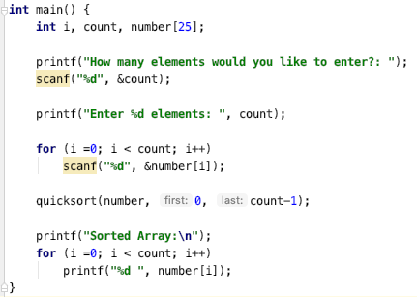
Quick Sort - Implementation
Invoke quicksort providing as input the array and the index of the first and the last elements

Slide 38
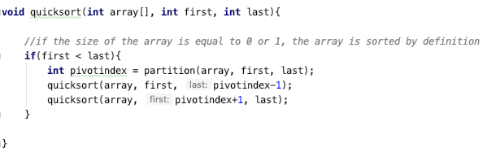
Quick Sort – Implementation
Invoke quicksort providing as input the array and the index of the first and the last elements
It sorts the array only when the size of the array is greater than 1.
Otherwise, the array is sorted by definition.

Slide 39
Quick Sort – Implementation
Invoke quicksort providing as input the array and the index of the first and the last elements
Identifies the index of the pivot using function partition
Sorts the element at the left and at the right of the pivot using the quicksort function.

Slide 40
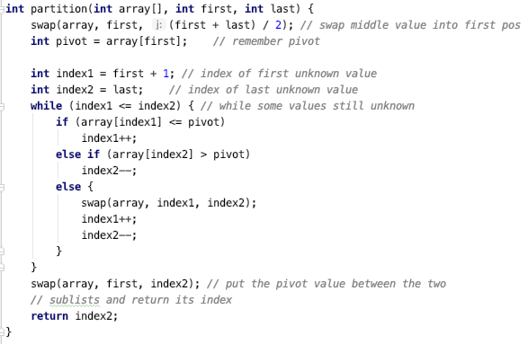
Quick Sort – Auxiliary Functions

Slide 41
Quick Sort – Auxiliary Functions
Swaps the middle value of the array and considers it as the pivot

Slide 42
Quick Sort – Auxiliary Functions
Considers the portion of the array at the right of the pivot. Remember the pivot is in the first position

Slide 43
Quick Sort – Auxiliary Functions
This cycle continues until the leftmost index becomes bigger than the rightmost index …

Slide 44
Quick Sort – Auxiliary Functions
Moves the leftmost index to the right if the pointed value is smaller than the pivot

Slide 45
Quick Sort – Auxiliary Functions
Moves the rightmost index to the left if the pointed value is bigger than the pivot

Slide 46
Quick Sort – Auxiliary Functions
Otherwise, the elements pointed by the leftmost and the rightmost index are swapped.
The leftmost index is incremented and the rightmost index is decremented

Slide 47
Quick Sort – Auxiliary Functions
The pivot is swapped with the rightmost index
The index of the pivot is returned

